Slide 1
2023-08-22: Auckland update
Linking MotA & homologs tree to
Literature
Experimental data
Plan for paper
Core hypothesis test: polar vs. lateral – both monophyletic?
First systematic survey of functional & structural diversity of MotA homologs
Mapping on traits of interest
Feedback
Scheme for naming clades
Sources of trait data?
Introducing Jiahe Zhang

Slide 2
Results

Slide 3
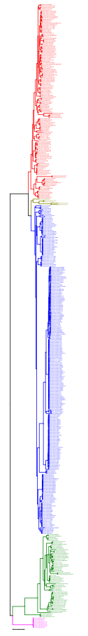
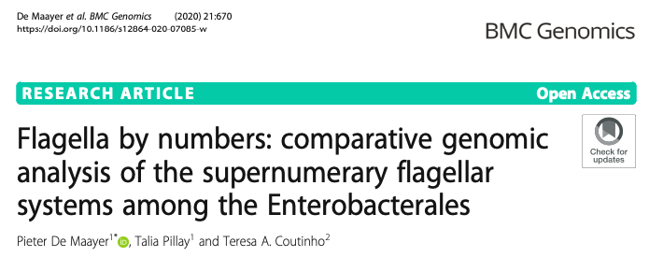
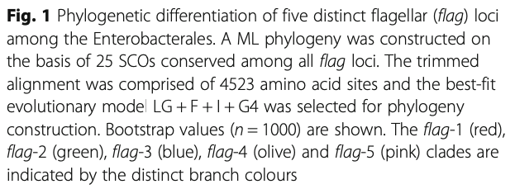
Linking MotA tree to the literature
flag-1
flag-4
flag-3
flag-2
flag-5

Slide 4
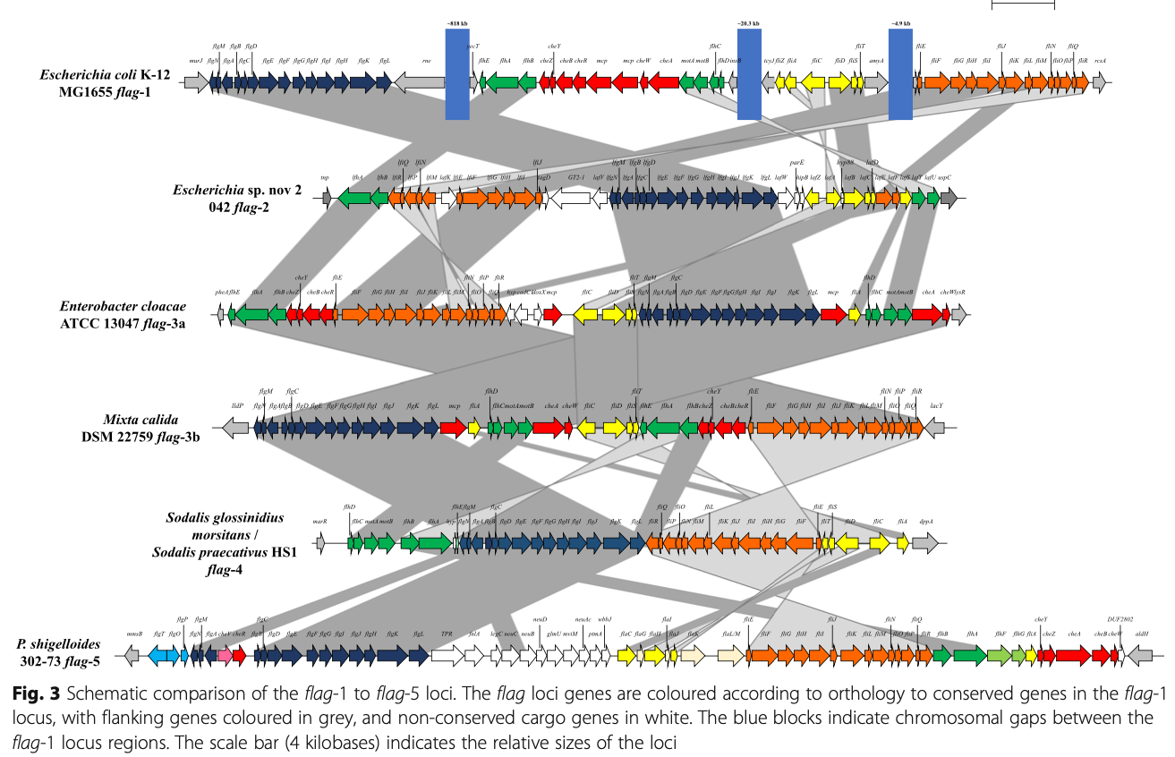
Locus gene orders: flag-1 to flag-5

Slide 5
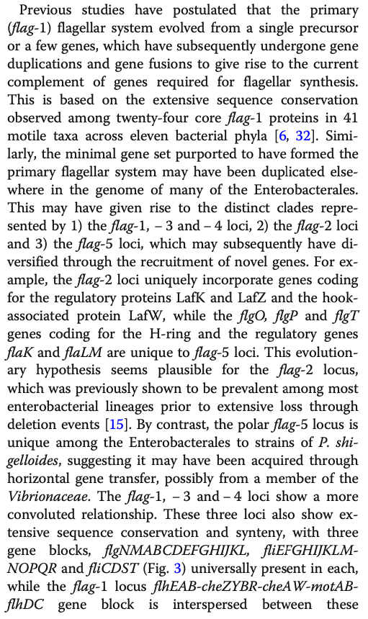
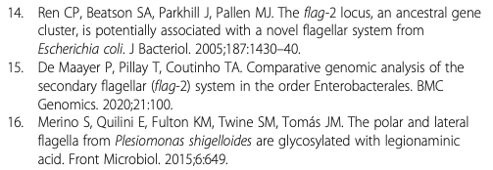
Boo!
Raging, stark-raving nonsense right here
(PS: If we want a quick paper, we could do one pointing out how Liu & Ochman 2007 PNAS is still causing problems/ misunderstandings, and blame the editor, Francisco Ayala, who is now deceased.)
This part is OK, but blinkered by the Enterobacteriales focus. Where do these clades go in the overall tree?

Slide 6
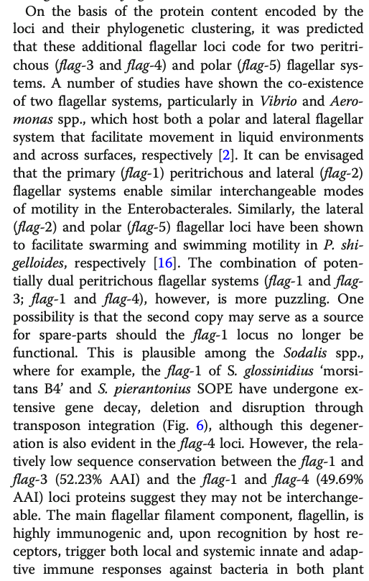
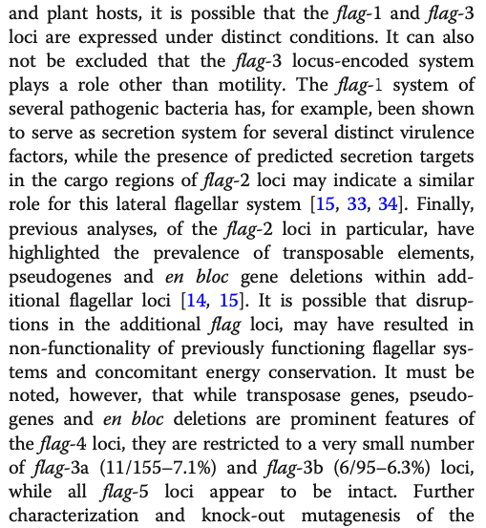
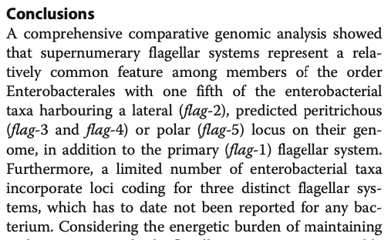
De Maayer et al. naming
“primary”
“predicted peritrichous”
“predicted peritrichous”
“secondary, lateral”
“polar”
flag-1
flag-4
flag-3
flag-2
flag-5

Slide 7
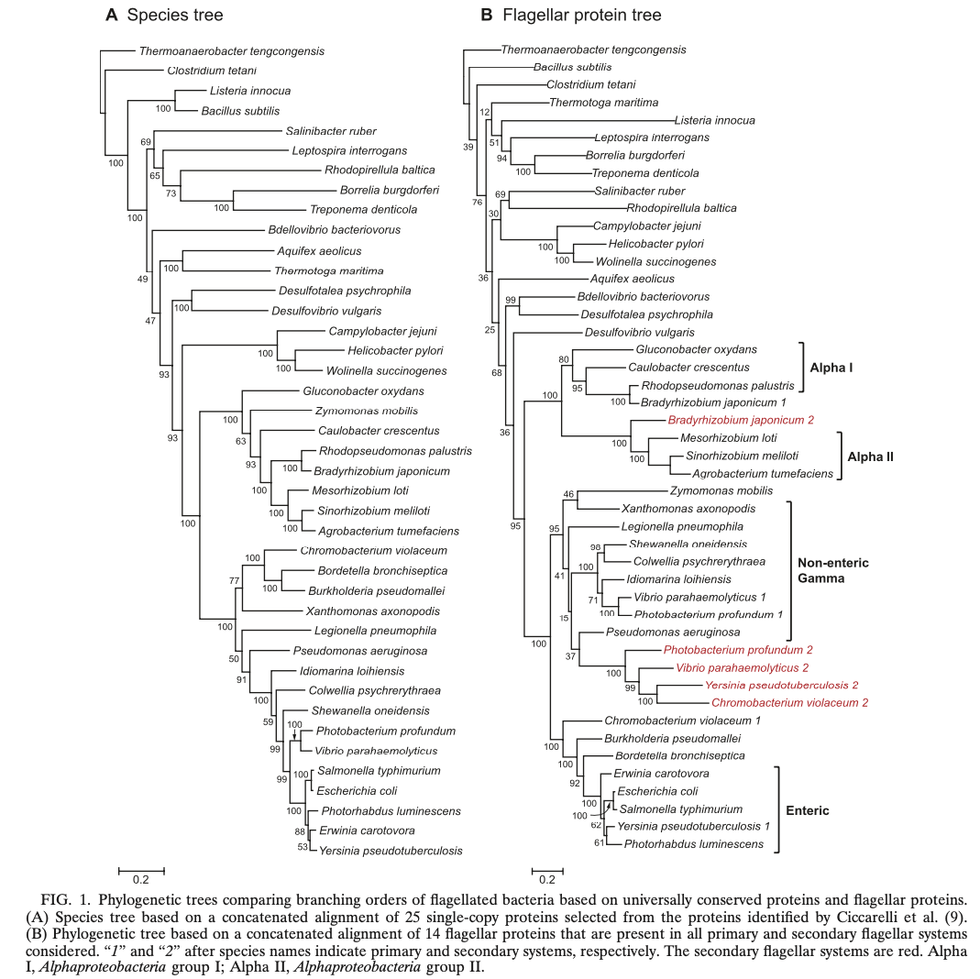
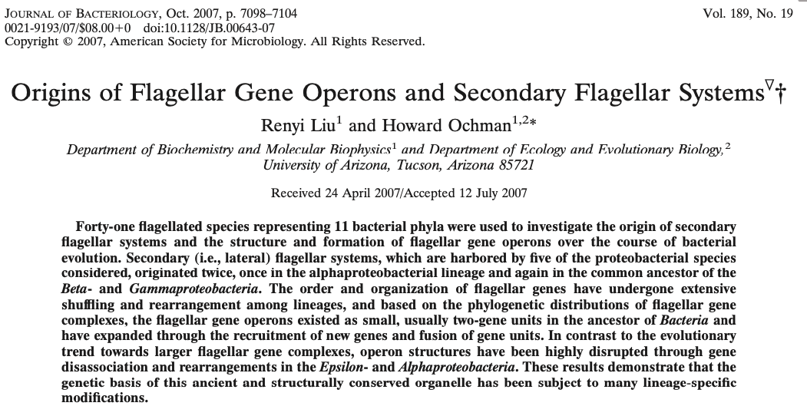
Liu & Ochman (2007) (the good one!)

Slide 8
Liu & Ochman (2007) (the good one!)
“secondary”

Slide 9
Liu & Ochman (2007) (the good one!)
Liu & Ochman:
red (”secondary”) systems duplicated within nonenteric gammas, then HGT independently to betas & enteros
“secondary”
Based on the organismal phylogeny, you might expect E. coli K-12 & friends up here in the gammas, rather than over with the Betaproteobacteria
(this was Ferreira, Beeby et al.’s point)

Slide 10
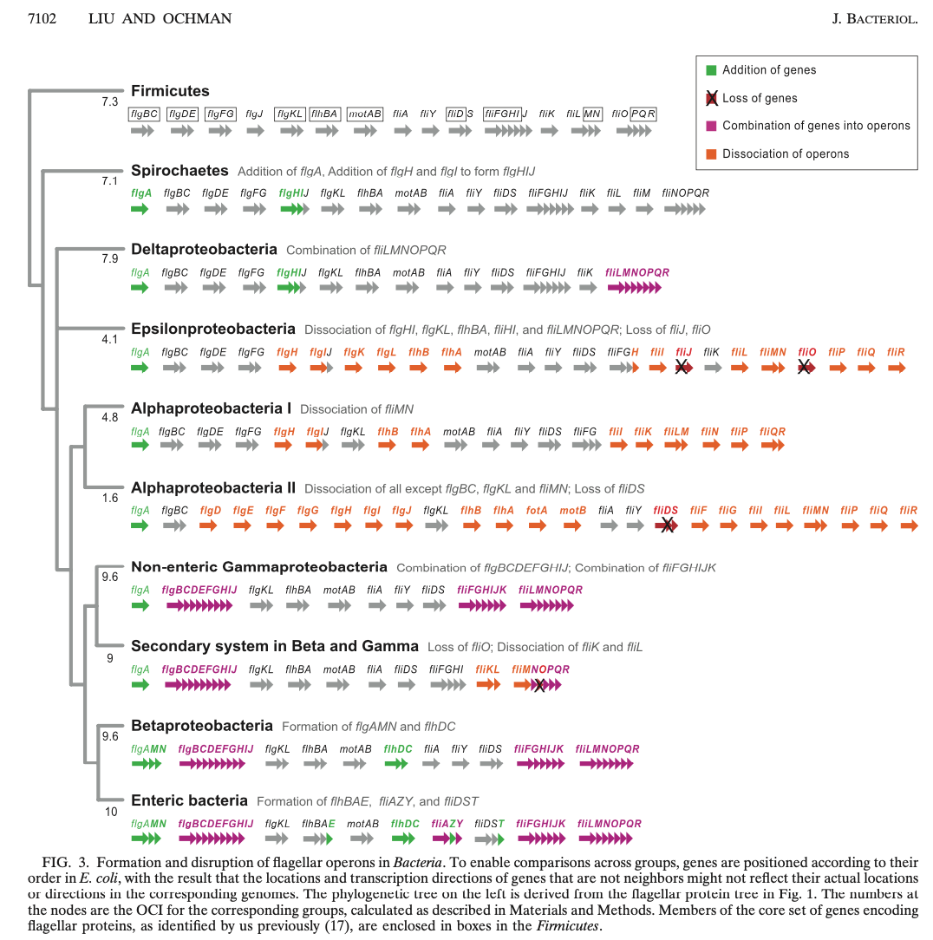
Liu & Ochman (2007) (the good one!)
This has the enteric primary systems next to the Betas, also…

Slide 11
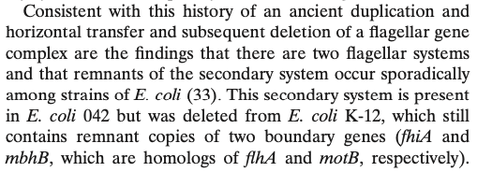
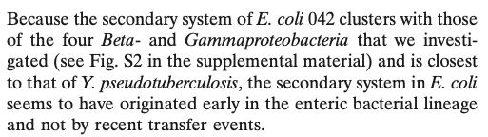
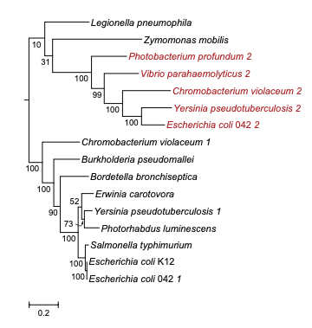
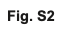
Liu & Ochman (2007) (the good one!)
E. coli 042’s secondary system follows the rest…
(why not in the main figure? Anyways…)

Slide 12
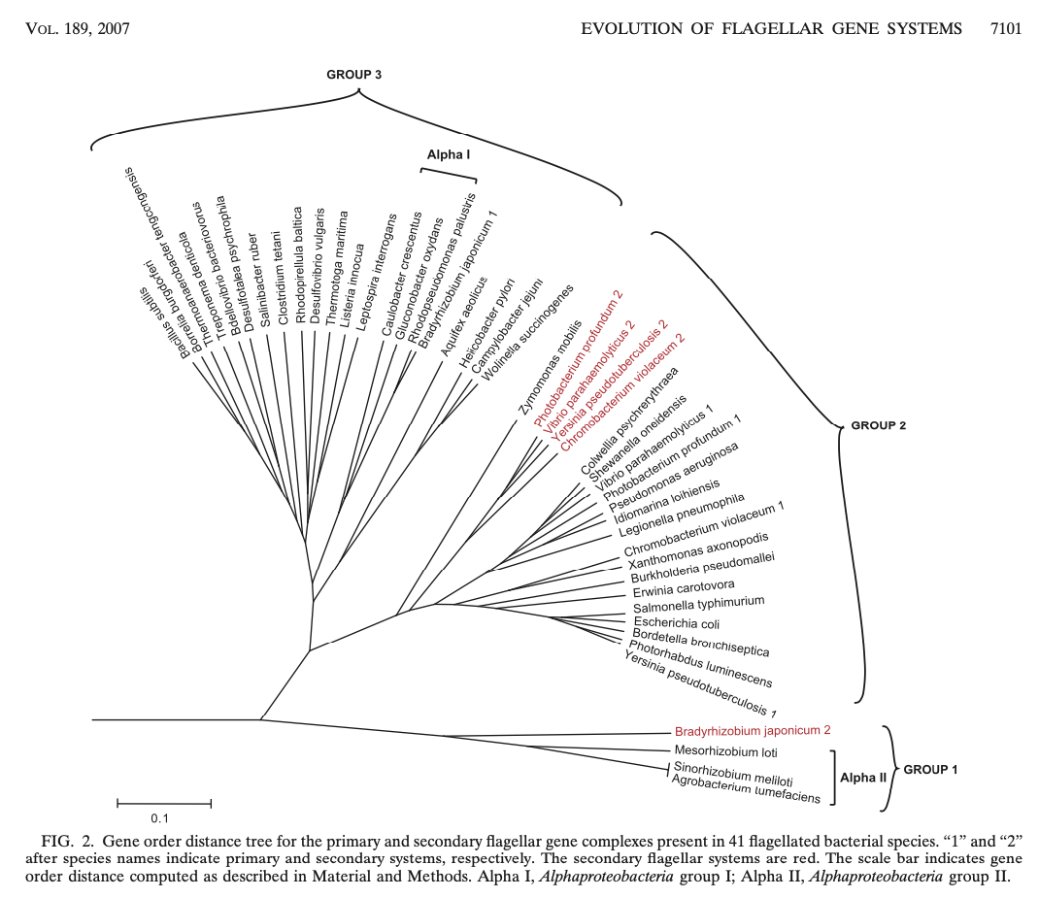
Liu & Ochman (2007) (the good one!)
“secondary”

Slide 13
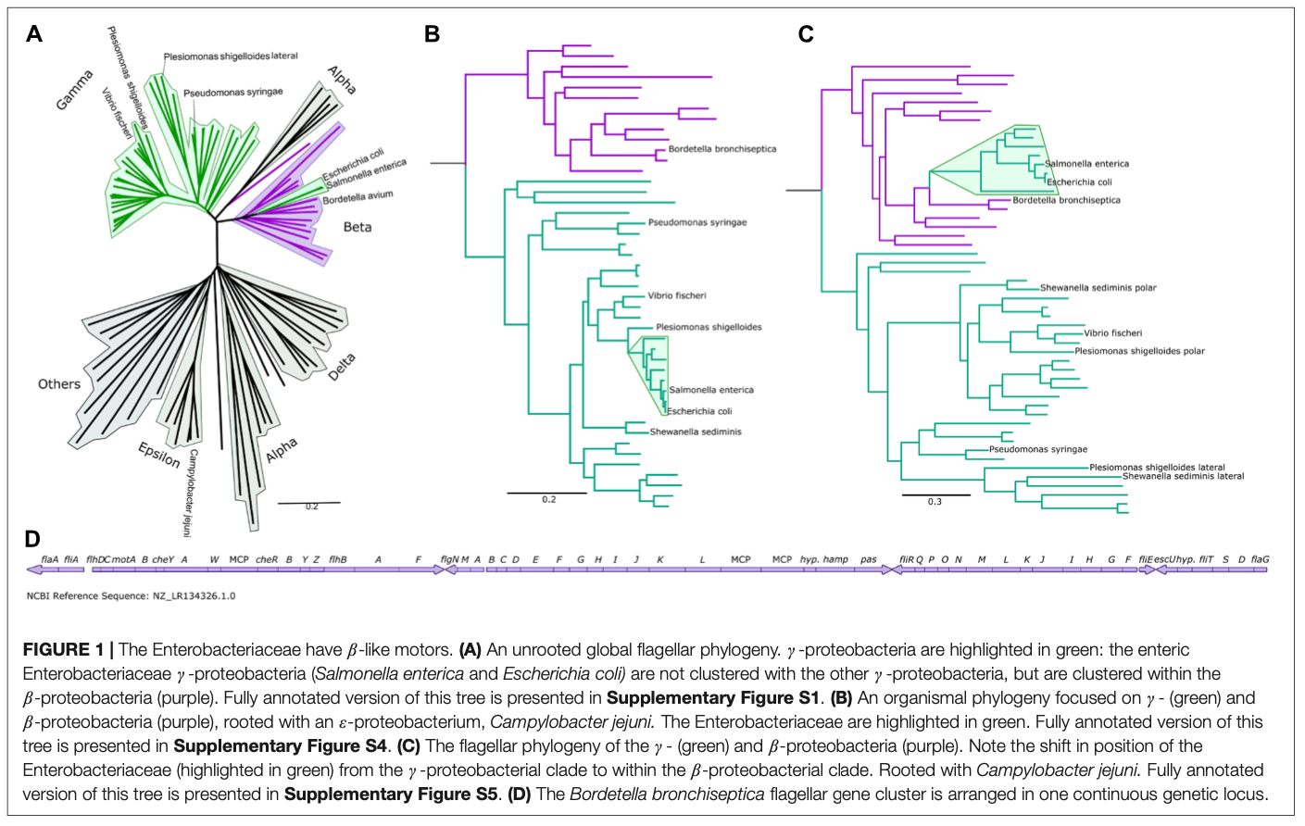
Ferreira, Beeby et al. 2021

Slide 14
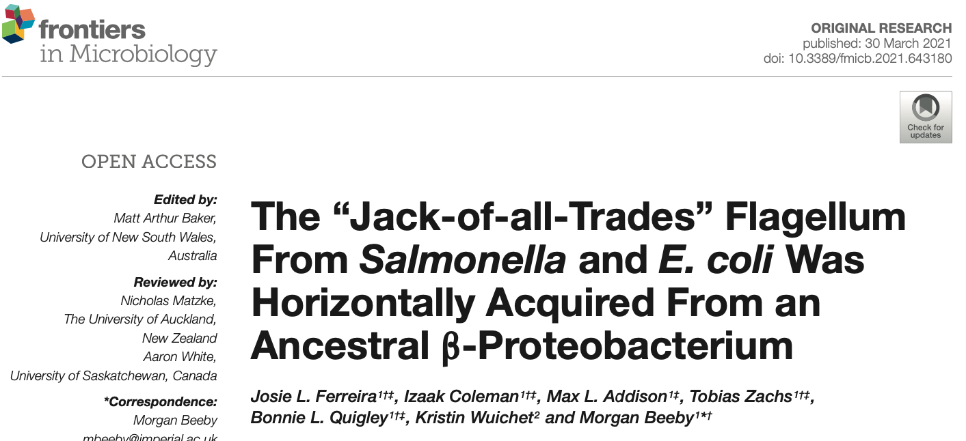
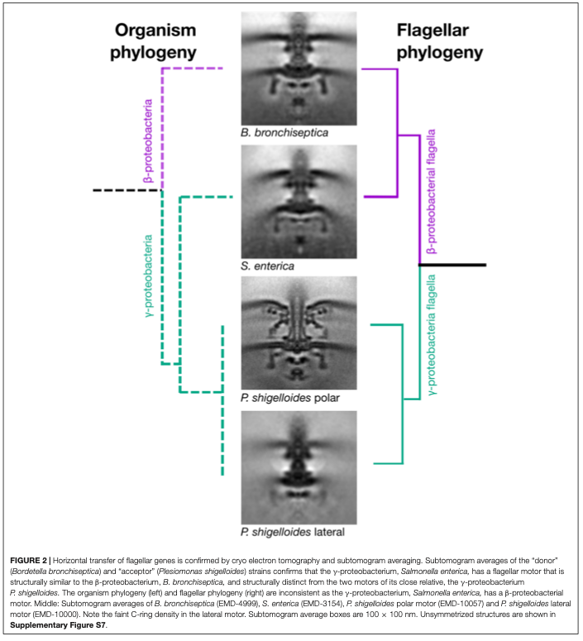
Ferreira, Beeby et al. 2021

Slide 15
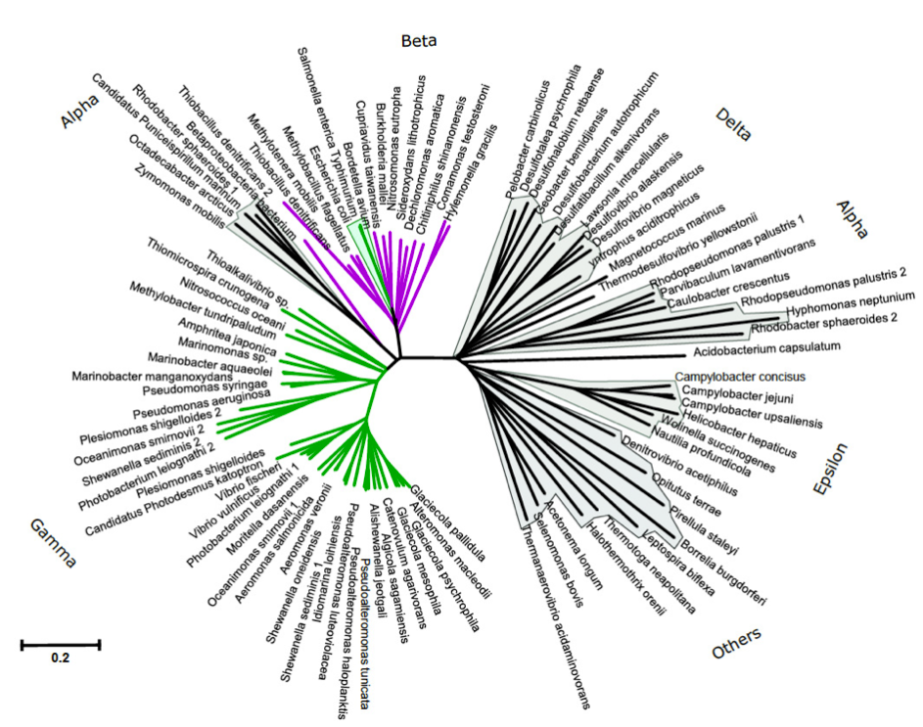
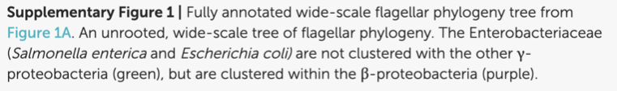
Ferreira, Beeby et al. 2021

Slide 16
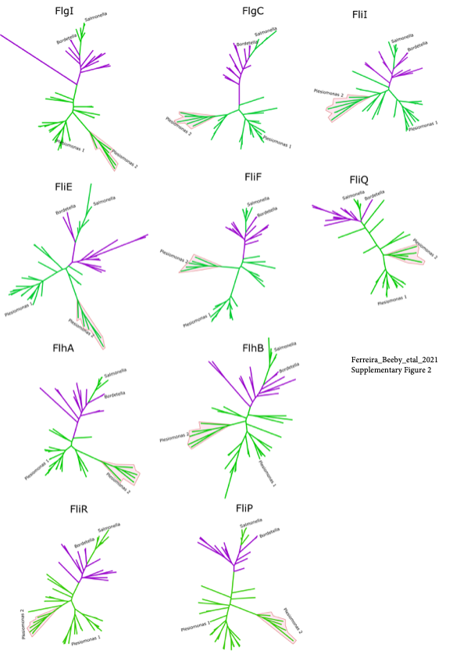
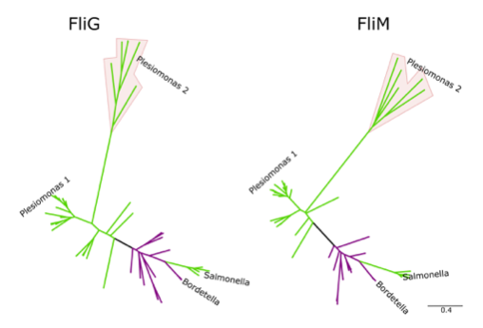
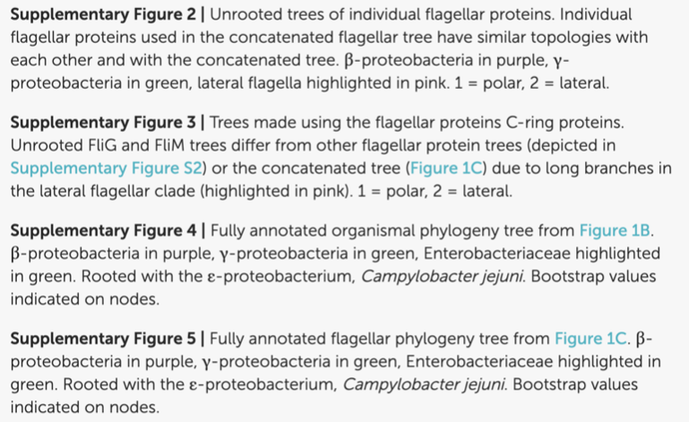

Slide 17
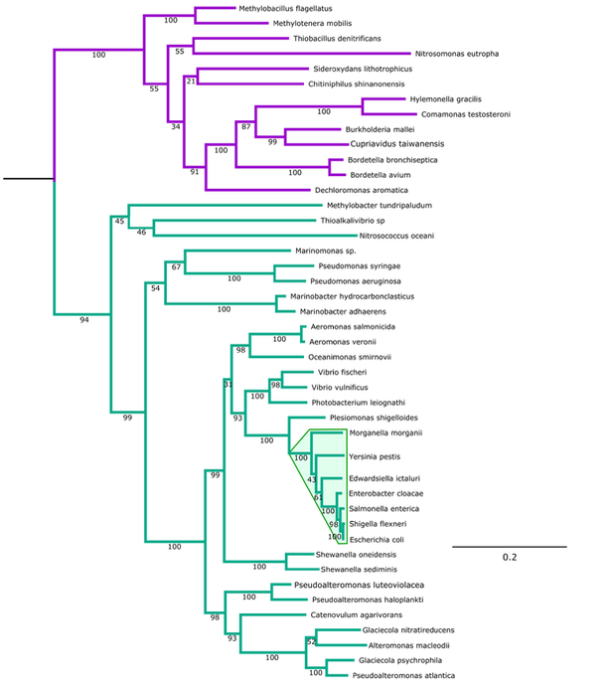
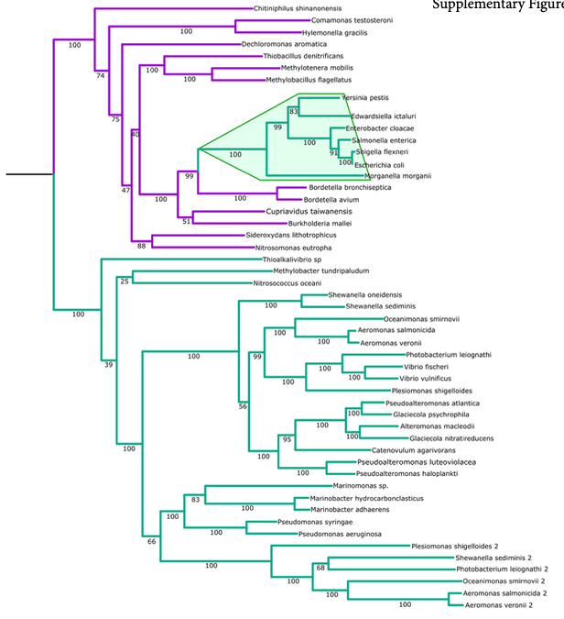

Slide 18
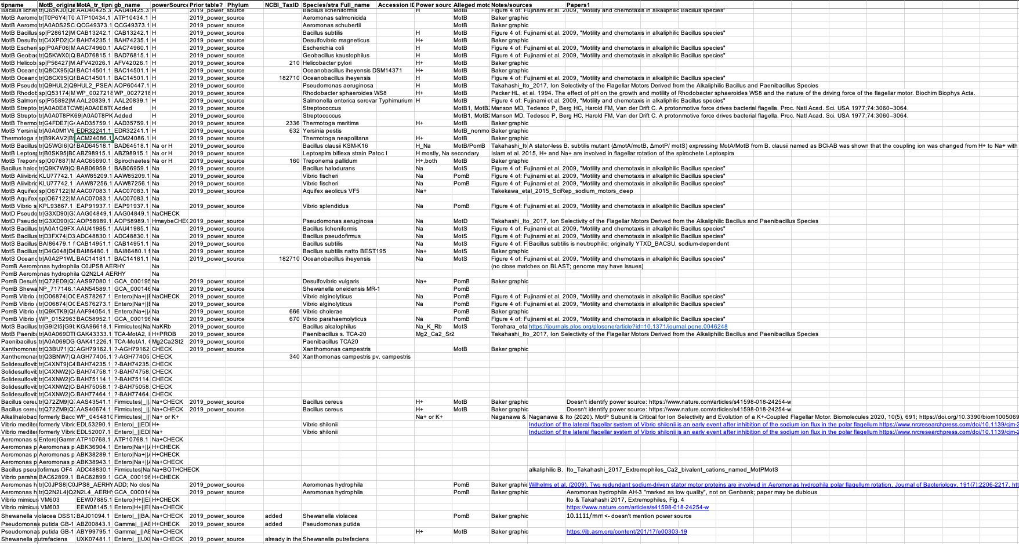
Power Sources

Slide 19
Methods
Downloaded genomes & annotations for all new / interesting taxa in previous papers
Pull homologs out of genomes with HMMER, against a pre-calculated AQB profile
Align against pre-calculated AQB profile
“Liberal” – regions flanking the AQB core are re-aligned with MAFFT script, leaving core alignment unchanged. (My theory of the case – this adds some more data & thus resolution; but really tests should be done w. several variants)
Phylo with IQtree, LG+G+F model (1-2 days to run on 1282 seqs)
FigTree: midpoint root, ladderize
Extensive UNIX cmds & R-script to unify tree & data tables in order, plot data & boxes

Slide 20
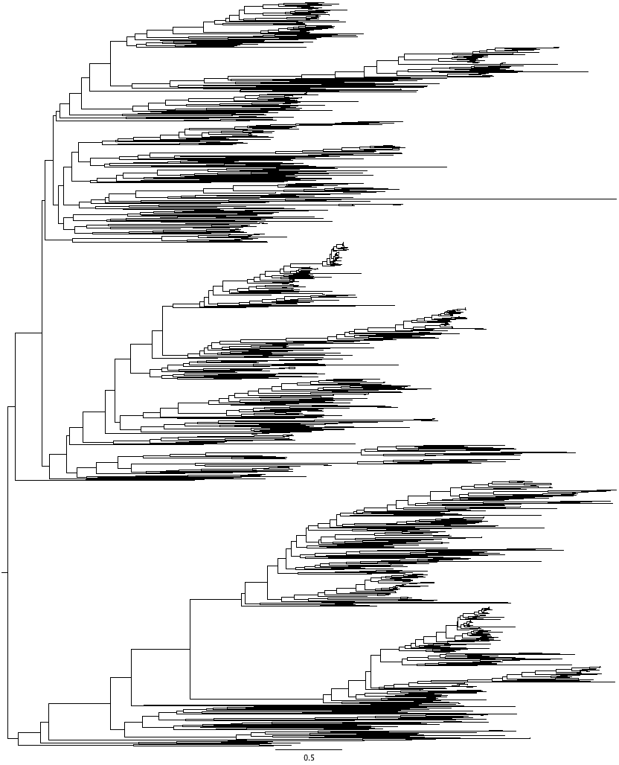
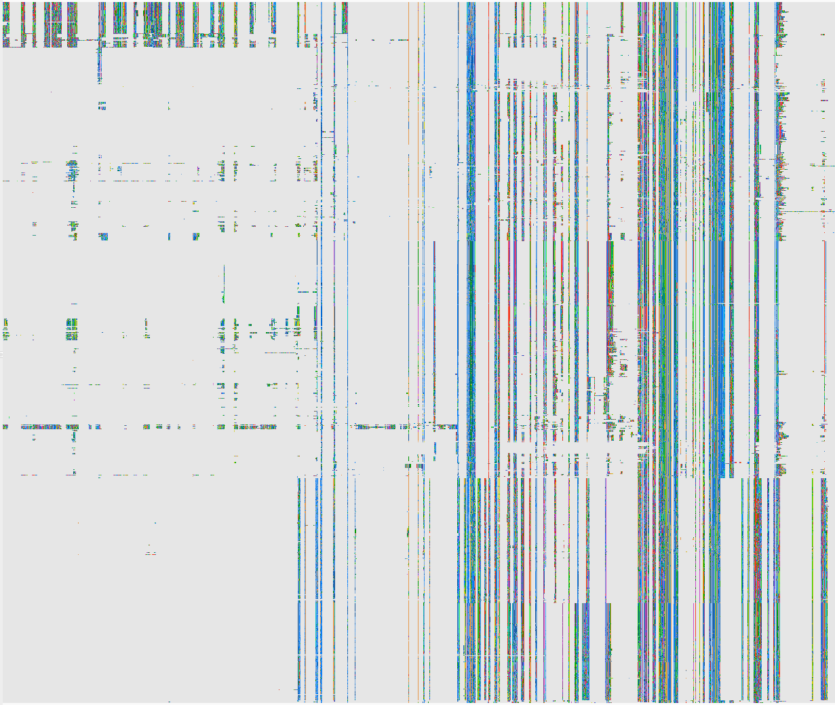
Results

Slide 21
Results

Slide 22

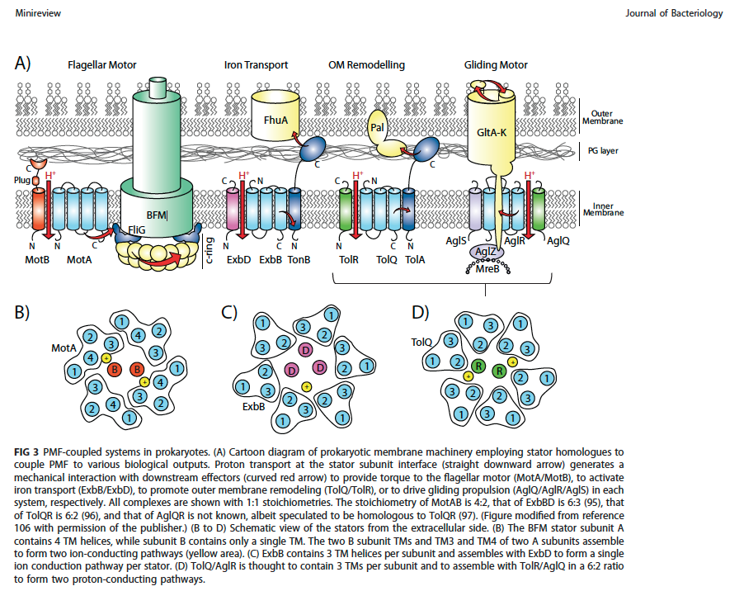

Slide 23
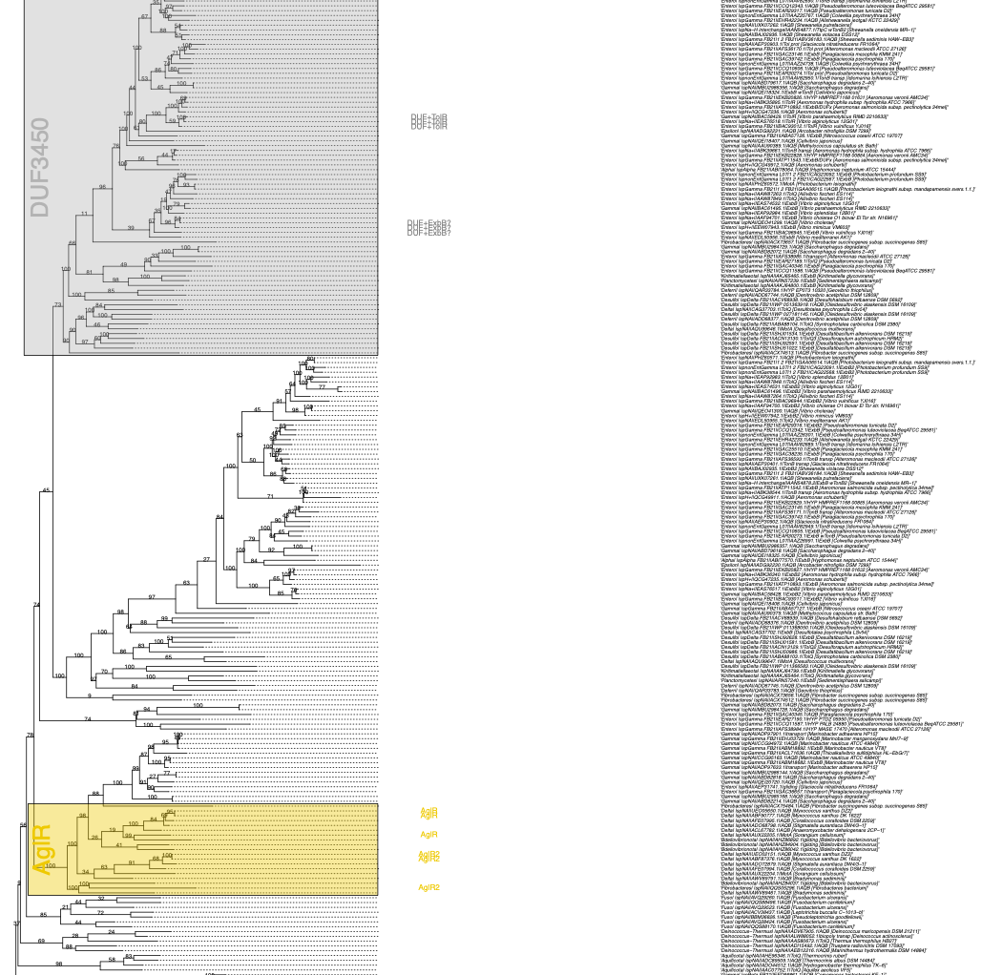
Results

Slide 24
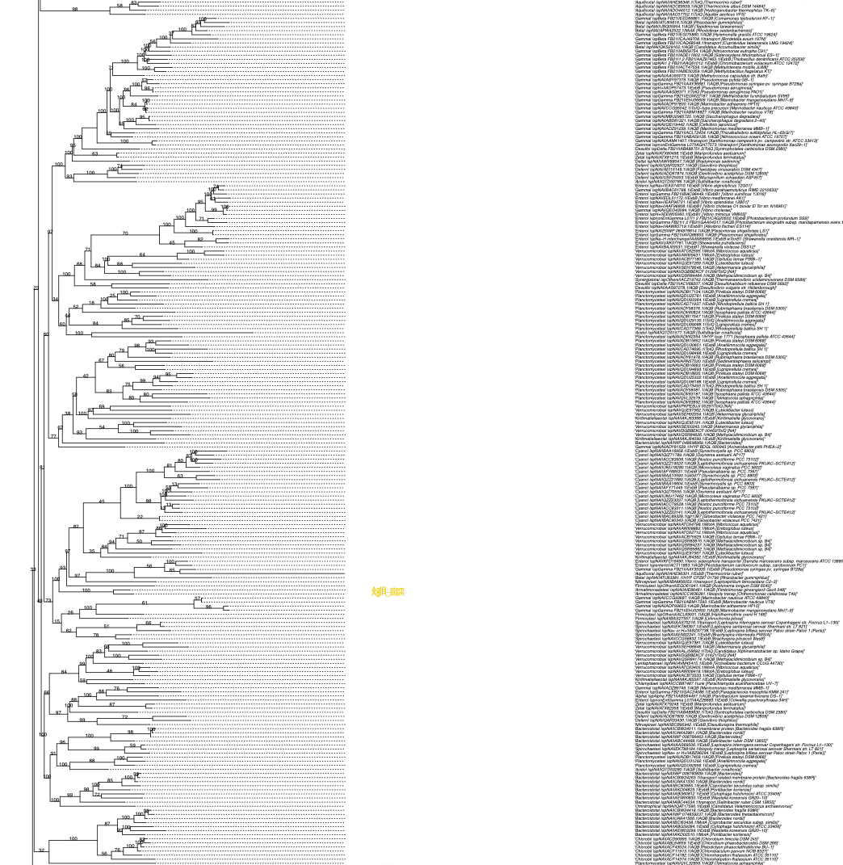
Results

Slide 25
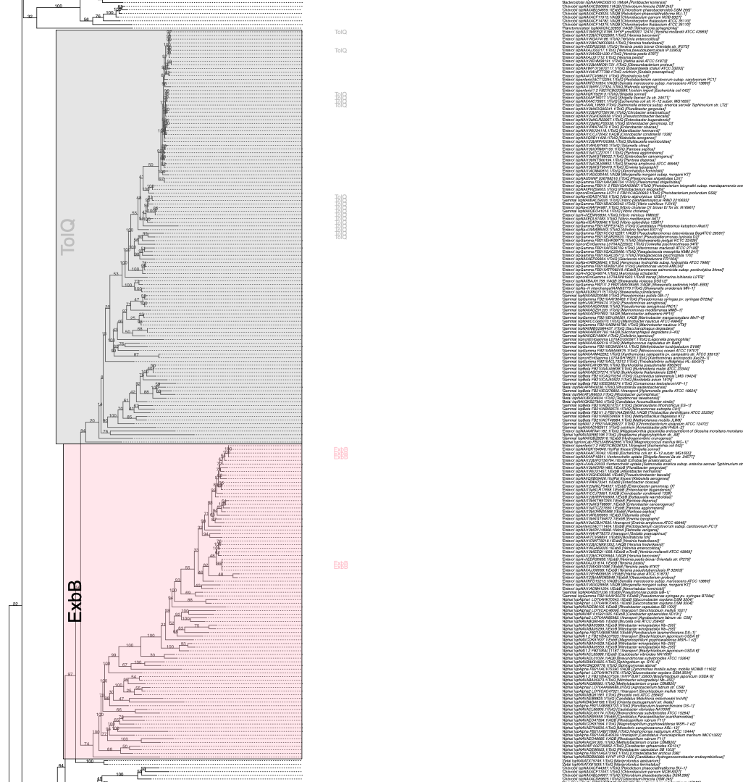
Results

Slide 26
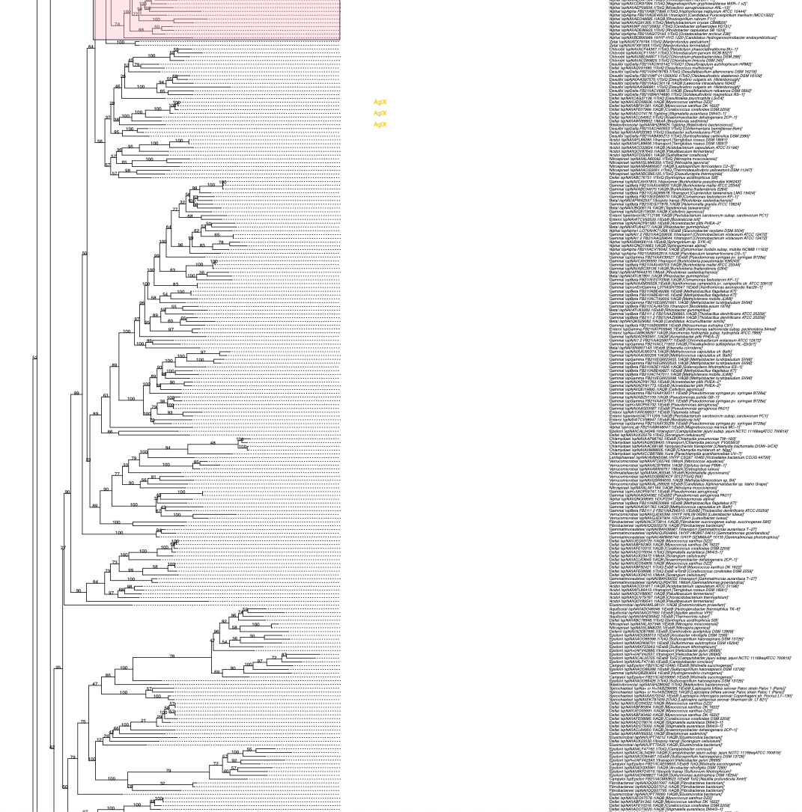
Results

Slide 27
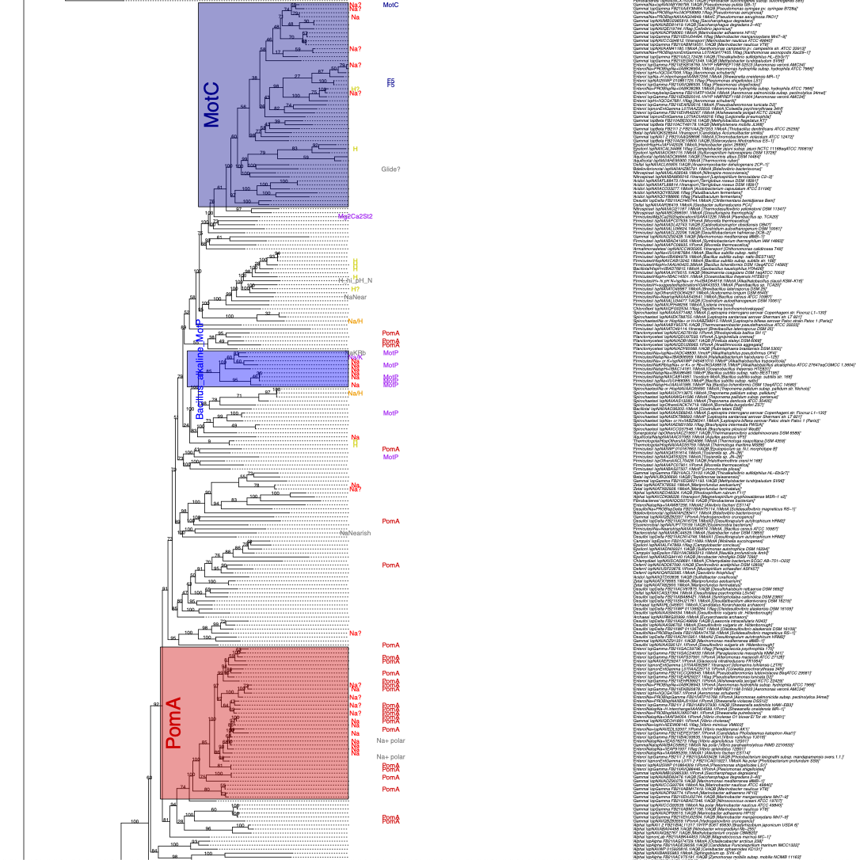
Results

Slide 28
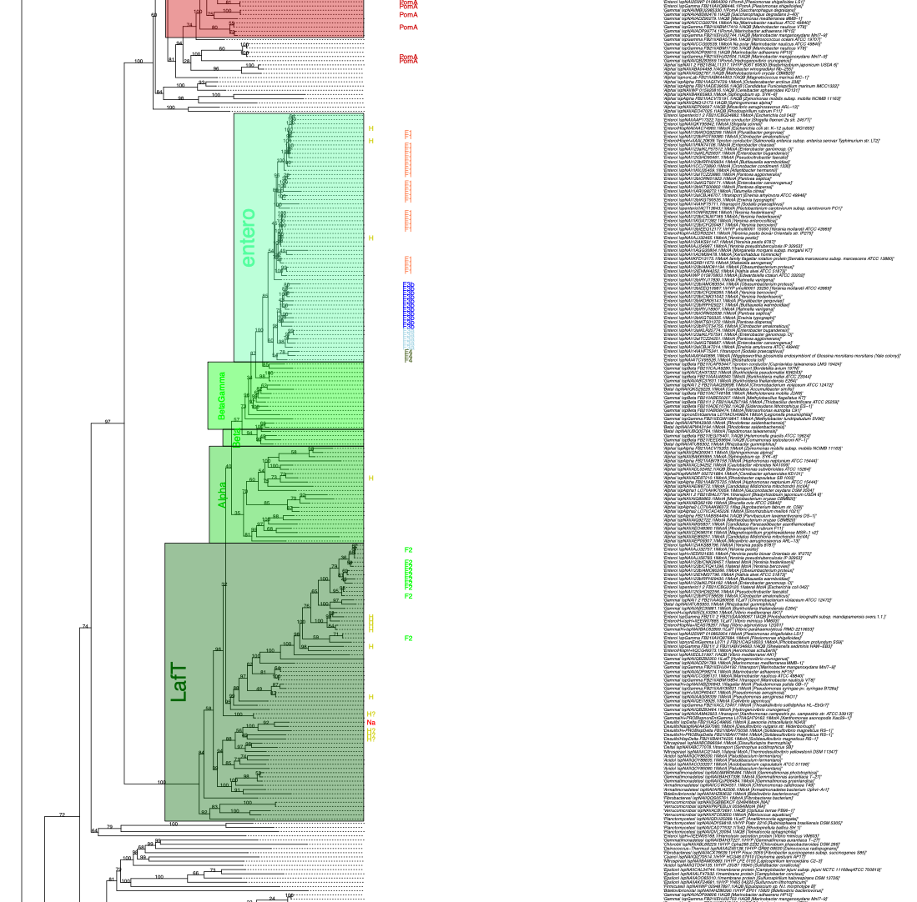
Results

Slide 29
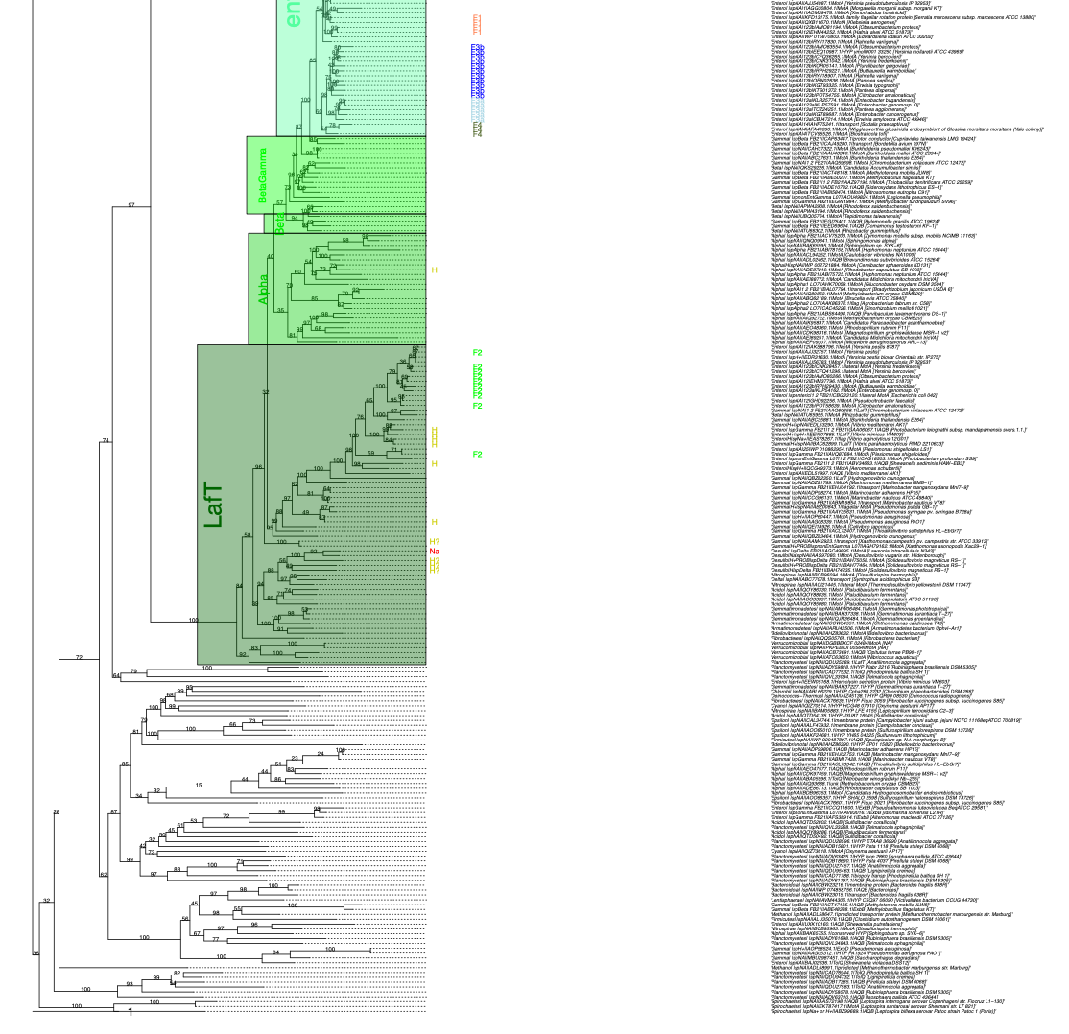
Results

Slide 30
Plan for paper
Plan for paper
Core hypothesis test: polar vs. lateral – both monophyletic?
Run IQtree tests to check robustness – on reduced datasets (~100 seqs instead of 1282)
Test 1: Liberal (all) vs. conservative (core only)
Test 2: Include vs. exclude HYP proteins (long branches & low signal may futz up deep relationships)
Test 3: conventional, pretty-good model (LG+G+F) vs. advanced model (C60, or 2-step approx. to C60)
Using full tree: First really systematic overview of functional & structural diversity of MotA homologs
Mapping on traits of interest
Naming major clades, to guide future research/communication
Feedback?
Scheme for naming clades
Additional sources of trait data?

Slide 31
Jiahe Zhang
Master in Biotechnology student starting this semester; part of University of Auckland’s NEFU program (Northeast Forestry Univ., Harbin, China)
Six months research project (2024)
Plan: use AlphaFold predictions to characterize protein structure across MotA tree
Aim: seek patterns/correlations between structure and: clades, environment, etc.

